Slide 1
Modification of a High-Speed Jet for Study of Active Flow Control
Advisor: Prof. Jesse Little
Department of Aerospace and Mechanical Engineering
Nicolas Urias
Arizona Space Grant Consortium Symposium
April 12th, 2014
Tucson, AZ

Slide 2
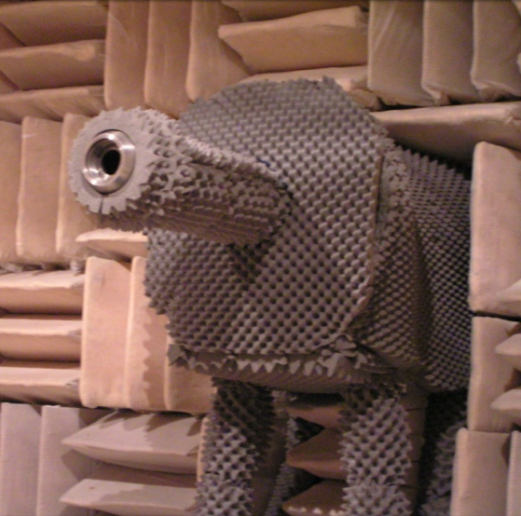
Introduction
High speed jet located inside anechoic chamber
Operated by high pressure tanks
Initial pressure of 1750 psi
System drops pressure to 300 psi in settling chamber
Lucas 2011

Slide 3
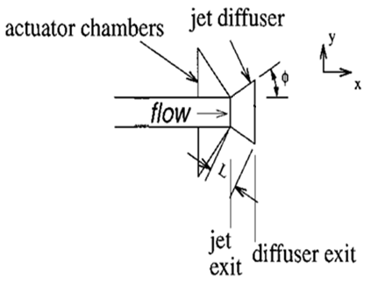
Active Flow Control Background
Control of turbulent jet structures
Actuators are installed along the inside wall of diffuser
Allows some control of where the fluid attaches to wall of diffuser
Thrust Vectoring in aircraft/spacecraft
Pack and Seifert 2001

Slide 4
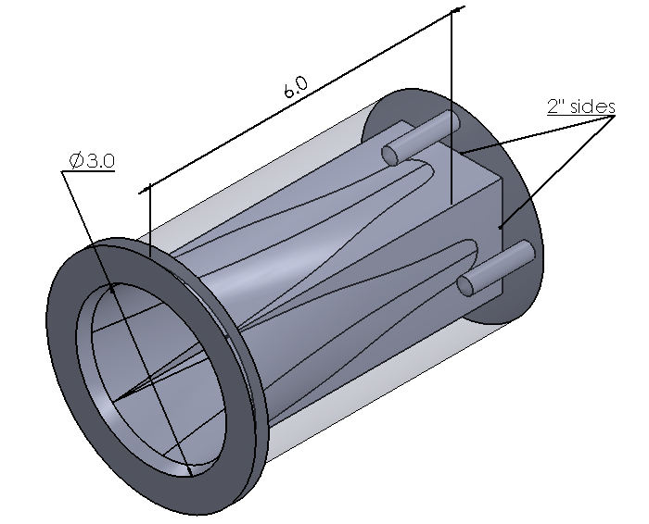
Circle to Square Transition Block
Designed to fit existing jet facility
Converts circular flow to simplified 2D flow
Simpler to install actuators
Had to match existing internal jet nozzle exit angle
Required many measurements

Slide 5
Circle to Square Transition Block
Square had to fit inside circle to be machinable
Designed using SolidWorks to obtain high machined precision
Contours of the part could NOT be produced with traditional machining tools
Outsourced machining work to specialists
Notes:
How about mentioning some of the design criteria (pressure, area change, length, etc.).

Slide 6
Circle to Square Transition Block
Part could only be wire electric discharged machined (Wire EDM).
High tolerances could be achieved (ten thousandth of an inch)
Required clearance for wire inside part
Part was to be made of Stainless Steel
Very durable and “easily” machined
Could handle the weight of all other flow control components attached to the downstream end

Slide 7
Wire EDM

Slide 8
Illustration of Contours

Slide 9
Issues with Design
Wire EDM machinist could not get exact contours of adapter block
SolidWorks Education Edition not suitable for high-quality .DXF exportation
Virtually no way to program wire EDM machine to produce the exact part required

Slide 10
Issues with Design
Dramatized contour showing discontinuity

Slide 11
Test Apparatus Setup
A flat plate mounts to C-S transition block
2D diffuser mounts to the flat plate
Actuators inserted into diffuser cone
Can achieve thrust vectoring and noise reduction in nozzle exhausts

Slide 12
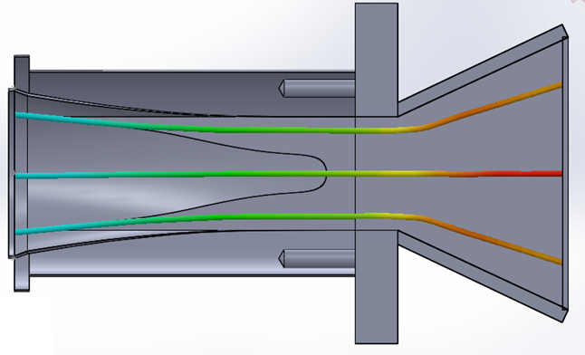
Test Apparatus Setup
Actuator location
Inlet
Outlet
Diffuser cone
Flat plate

Slide 13
Test Apparatus Setup

Slide 14
Future Tasks
Finding a solution for the SolidWorks to .DXF conversion issue
Use NX Nastran software
Designed for aerospace companies
Design internal cavities for actuators
Design diffuser cone

Slide 15
Thank you!!
The NASA Space Grant
The A.F.S.O.R.
&
Special thanks Dr. Lutz Taubert, whom helped me with every aspect of this design project.

Slide 16
References
Pack, Latunia G., and Avi Seifert. "Periodic Excitation for Jet Vectoring and Enhanced Spreading." Journal of Aircraft 38.3 (2001): 486-95. Print.
Lucas, Nathaniel. IMPROVING FLOW RATE CONTROL FOR A SUPERSONIC TWIN NOZZLE AND REDUCING NOISE WITH FLEXIBLE FILAMENTS. Thesis. University of Arizona, 2011. N.p.: n.p., n.d. Print.

